Slide 1
Deep – Sea Fan Sediments

Slide 2
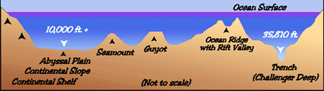
Continental shelf
Continental slope
Continental rise
Abyssal plain
Abyssal hills
Features of the Underwater World
Submarine canyon
Seamount
Guyot
Ridge
Trench

Slide 3
Continental slope:
the transition between the gently descending cont. shelf and deep-ocean basin
generally, 4 - 25º slope, 12 miles wide, 12,000ft deep
Continental Rise:
accumulation of sediment from turbidity currents
like an avalanche

Slide 4
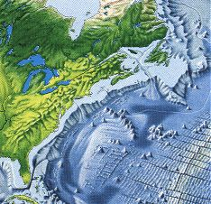
Abyssal plain:
flat featureless expanses of sediment formed by suspension settling
common in Atlantic
Abyssal hills:
small sediment covered extinct volcanoes
< 650 ft high

Slide 5
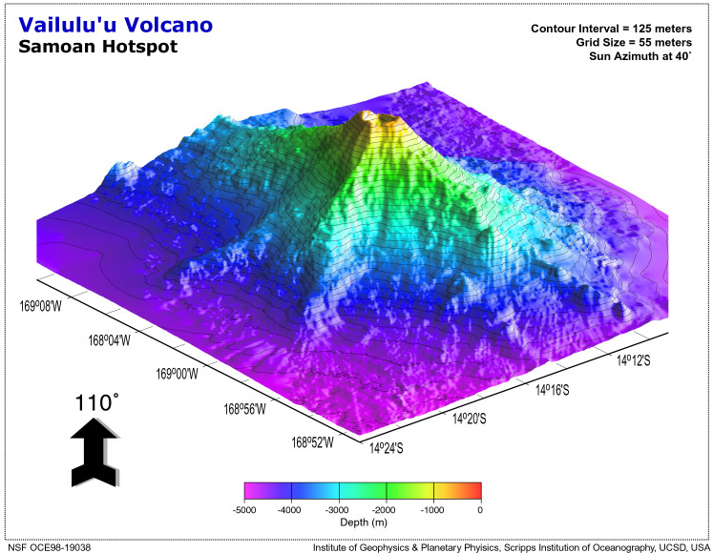
Sea mount:
volcanic projections that don’t rise above the surface of the sea
circular or elliptically shaped
many form at hot spots

Slide 6
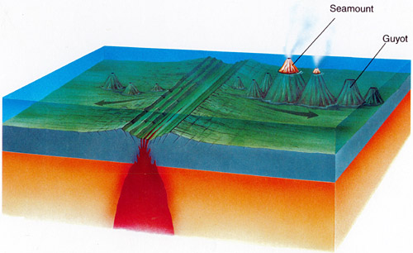
Guyot: flat topped sea mounts
volcanic

Slide 7
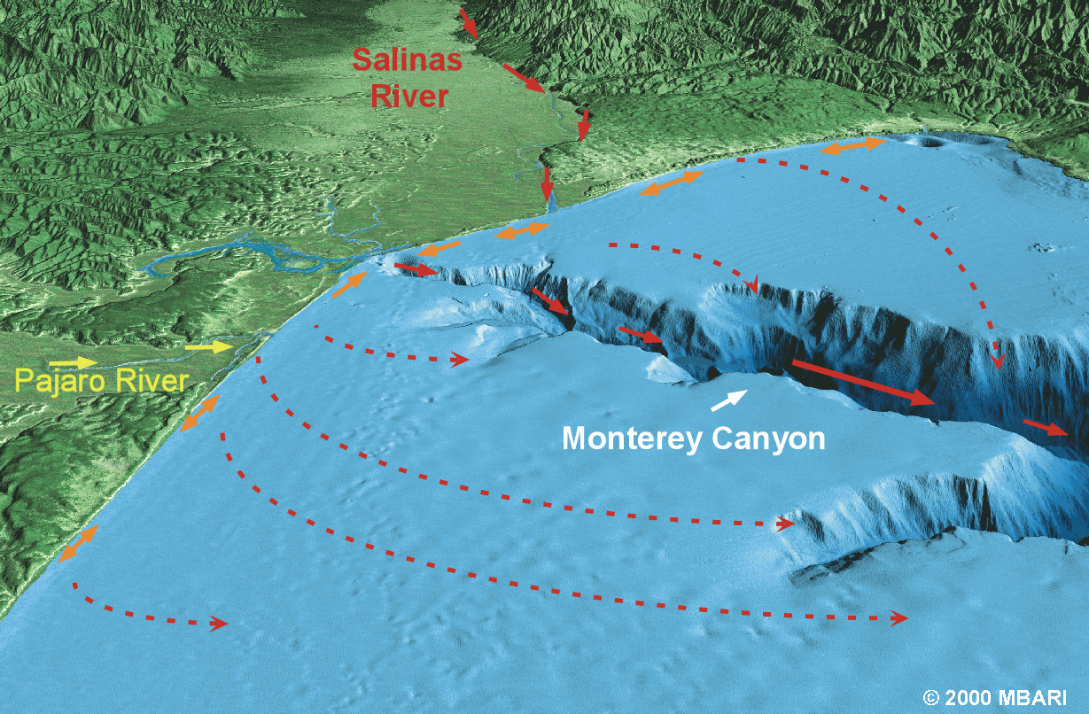
Submarine canyons:
Canyons that cut into continental shelf
Turbidity currents carve submarine canyons into the slope and shelf

Slide 8
slope
continental shelf
rise
abyssal plain
abyssal hills
ridge
transform fault

Slide 9
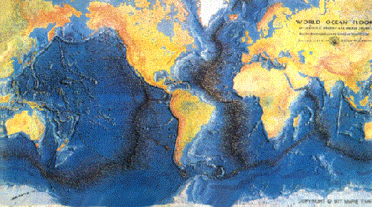
Ridges: mountainous chain of young basaltic rock at the active spreading center of the ocean

Slide 10
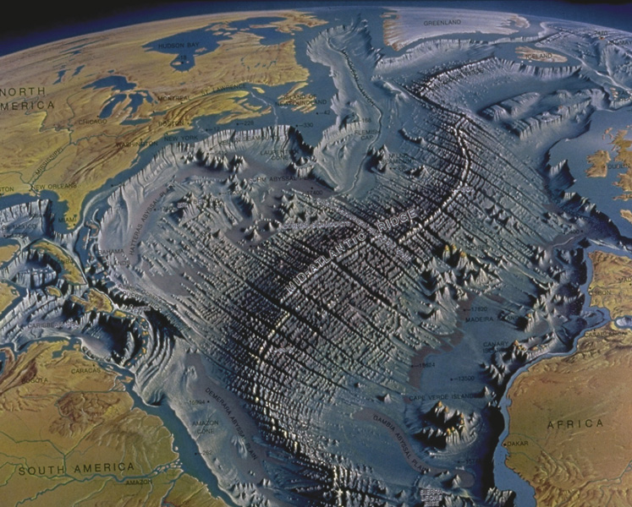
The Mid-Atlantic Ridge
Traverses the center of the Atlantic Ocean
Contains a central down-dropped rift valley
Surfaces in Iceland

Slide 11
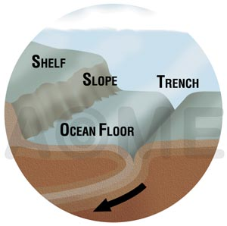
Trenches: arc-shaped depression in the deep ocean floor
Formed by plate convergence
Associated with volcanic arcs
  Island arc
  Continental arc
Most active geologic feature on earth

Slide 12
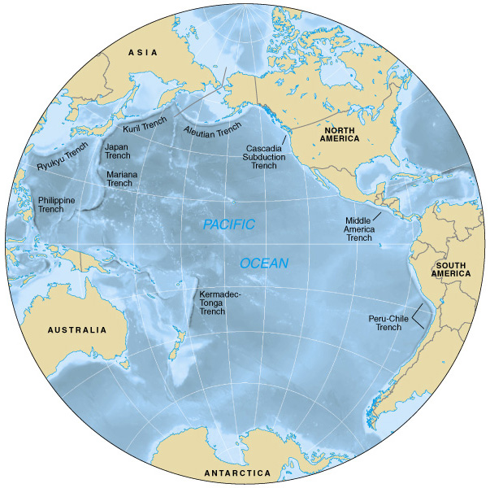
Ocean trenches
Most trenches are in the Pacific Ocean

Slide 13
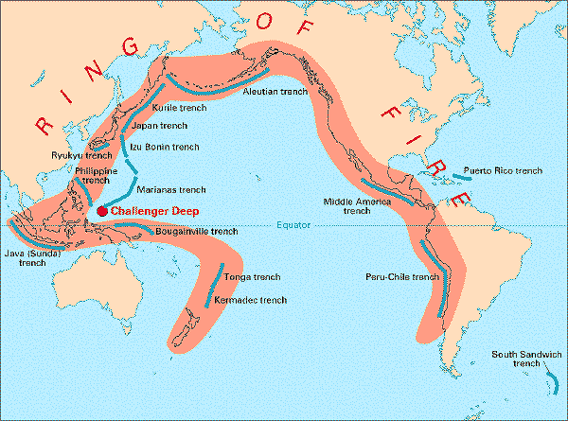
Location of Marianas Trench

Slide 14
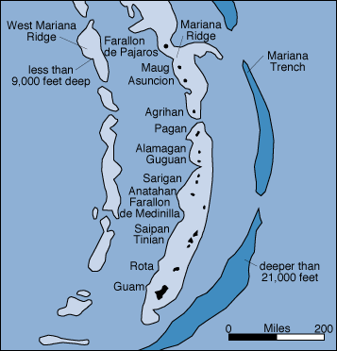
Location of Mariana Trench

Slide 15
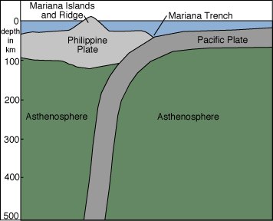

Slide 16
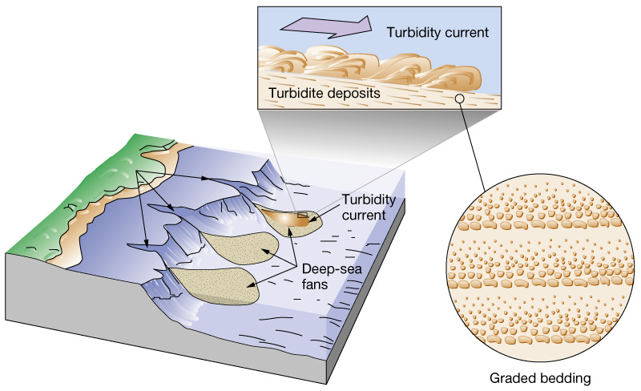
Submarine canyons and deep-sea fans
Moves sediment movement from the continents into the deep-sea via turbidity currents
Debris from turbidity currents creates graded bedding deposits and deep-sea fans

Slide 17
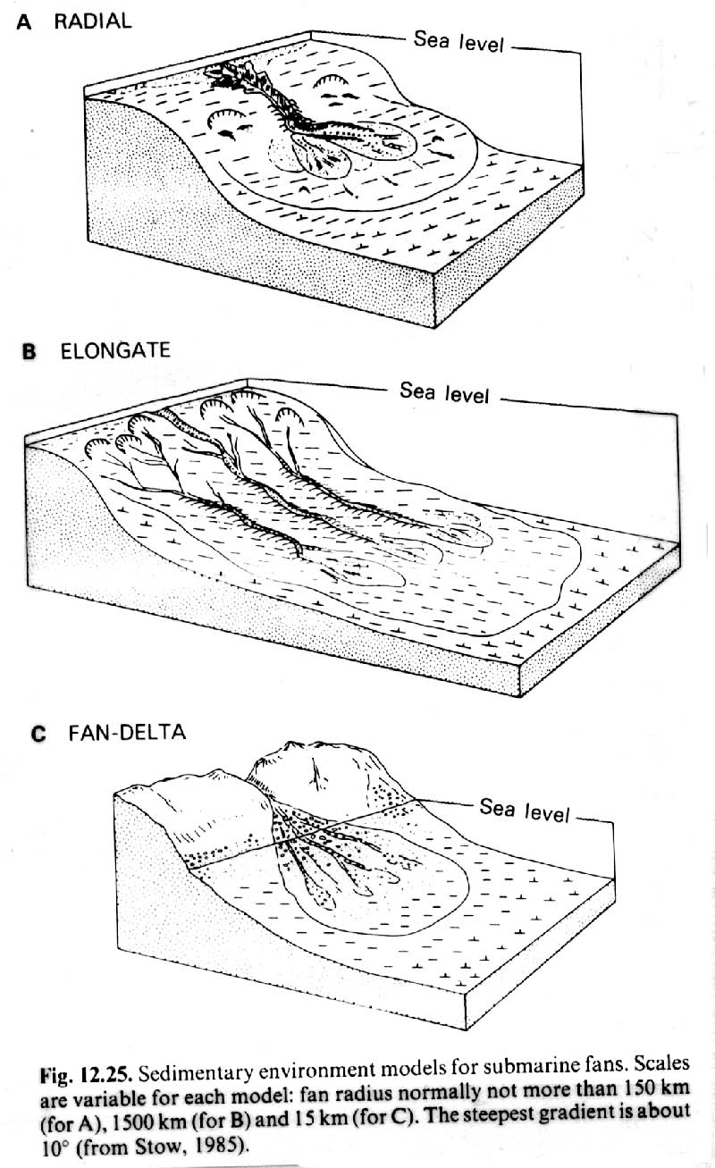
Styles of submarine fan

Slide 18
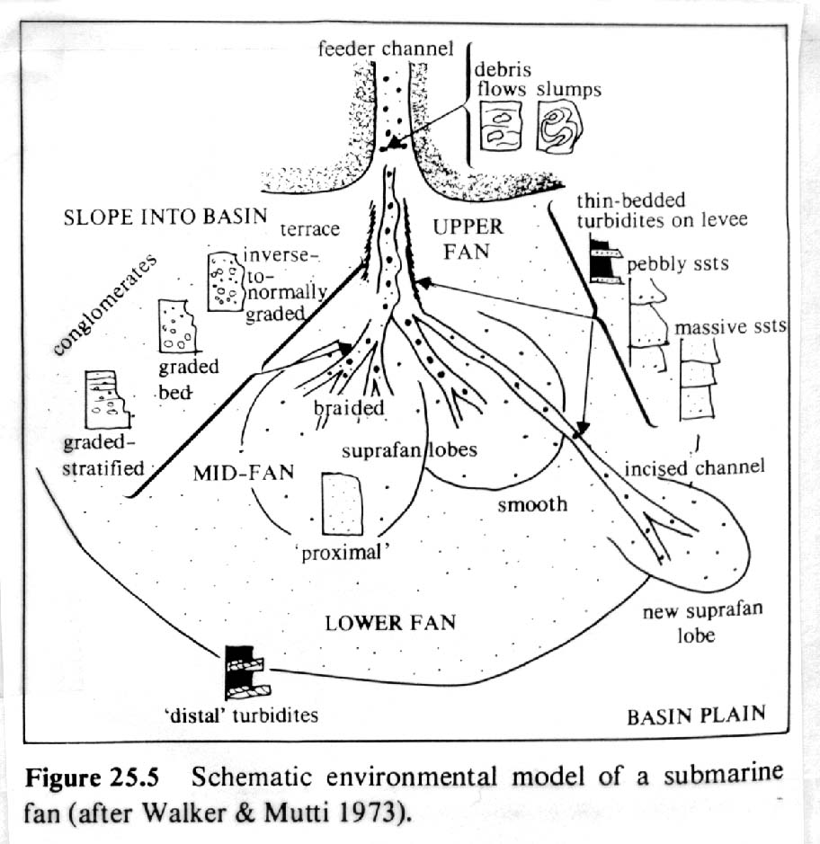
Schematic submarine fan

Slide 19
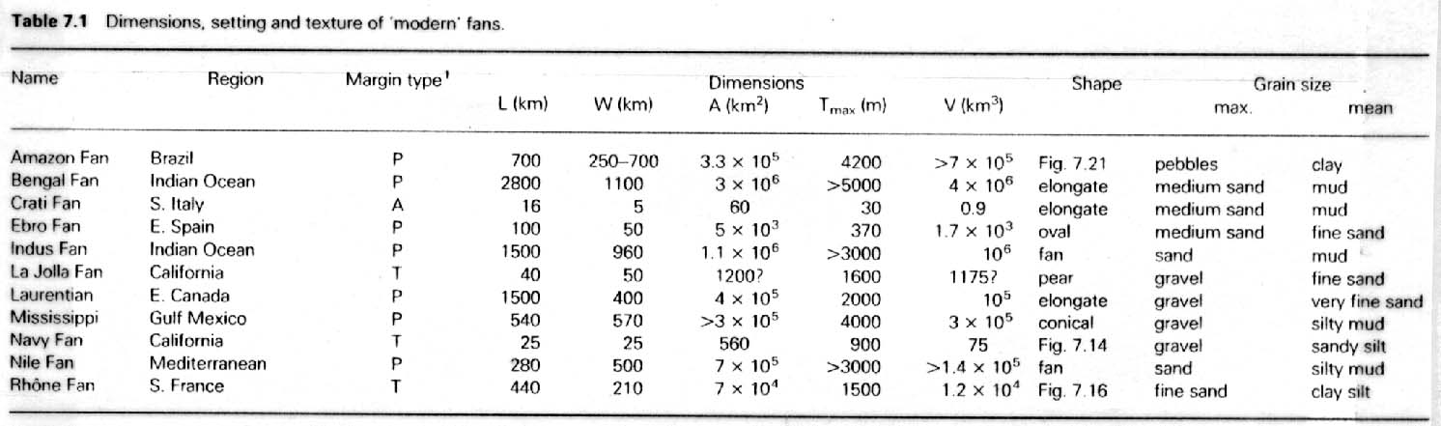
Modern submarine fan statistics

Slide 20
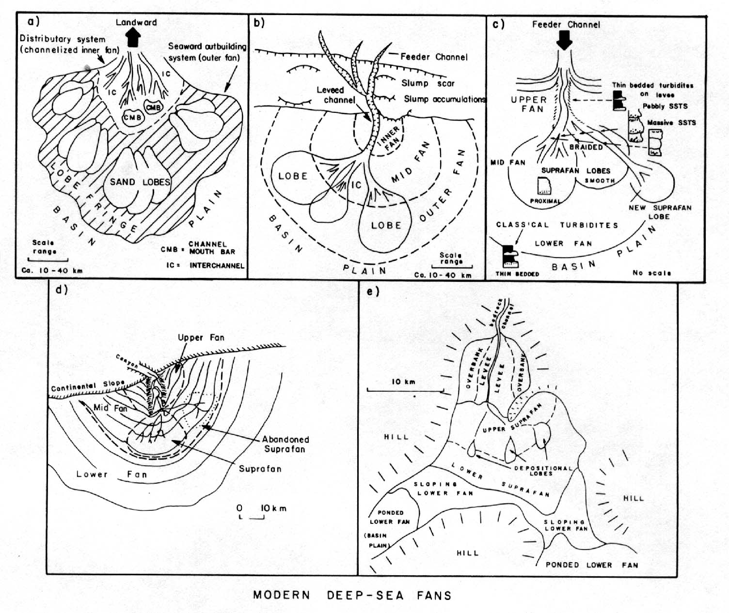
Modern submarine fan types- 1

Slide 21
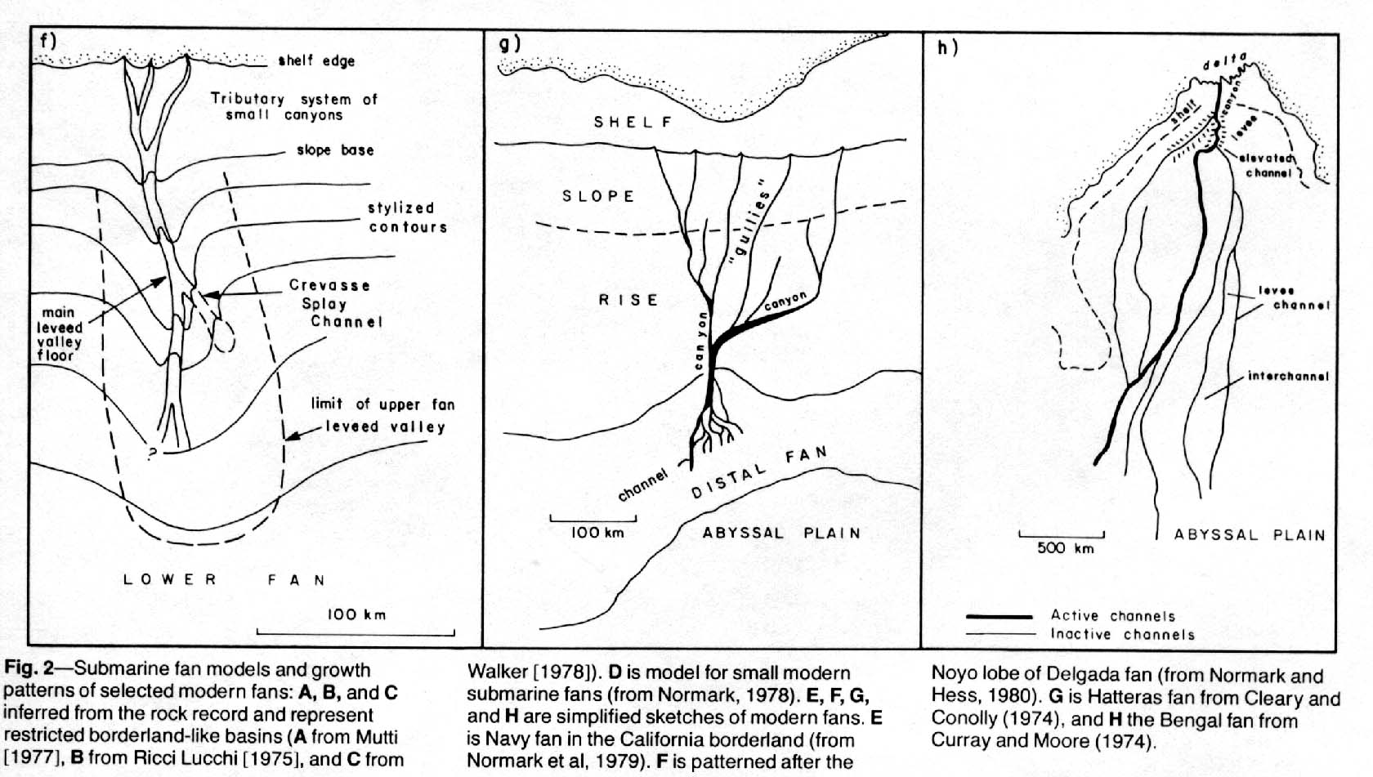
Modern submarine fan types 2

Slide 22
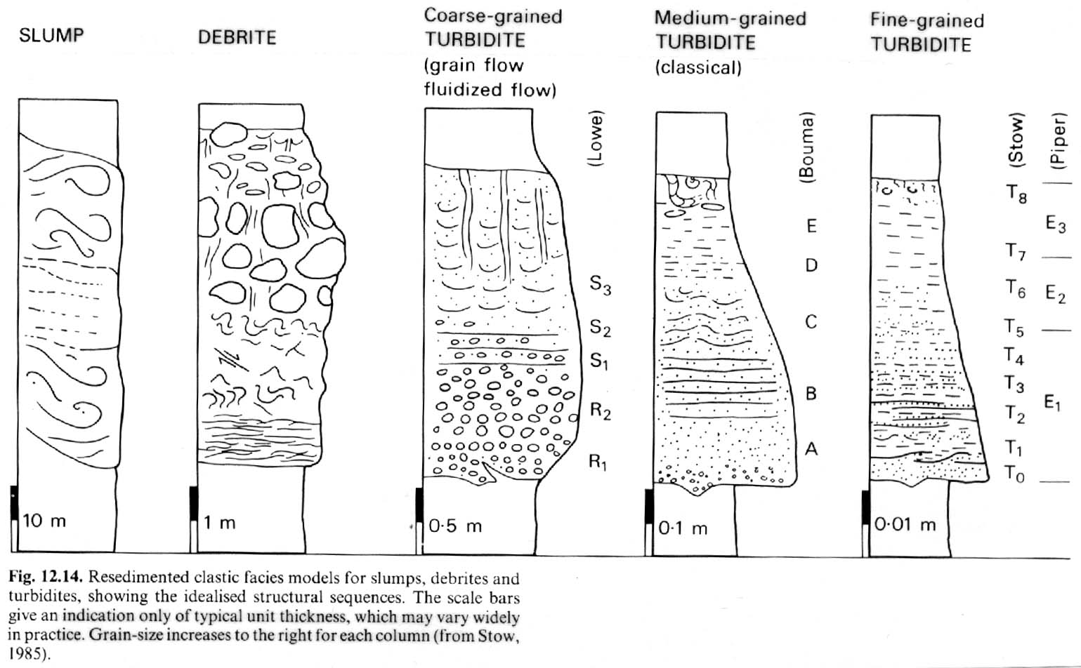
Submarine fan facies

Slide 23
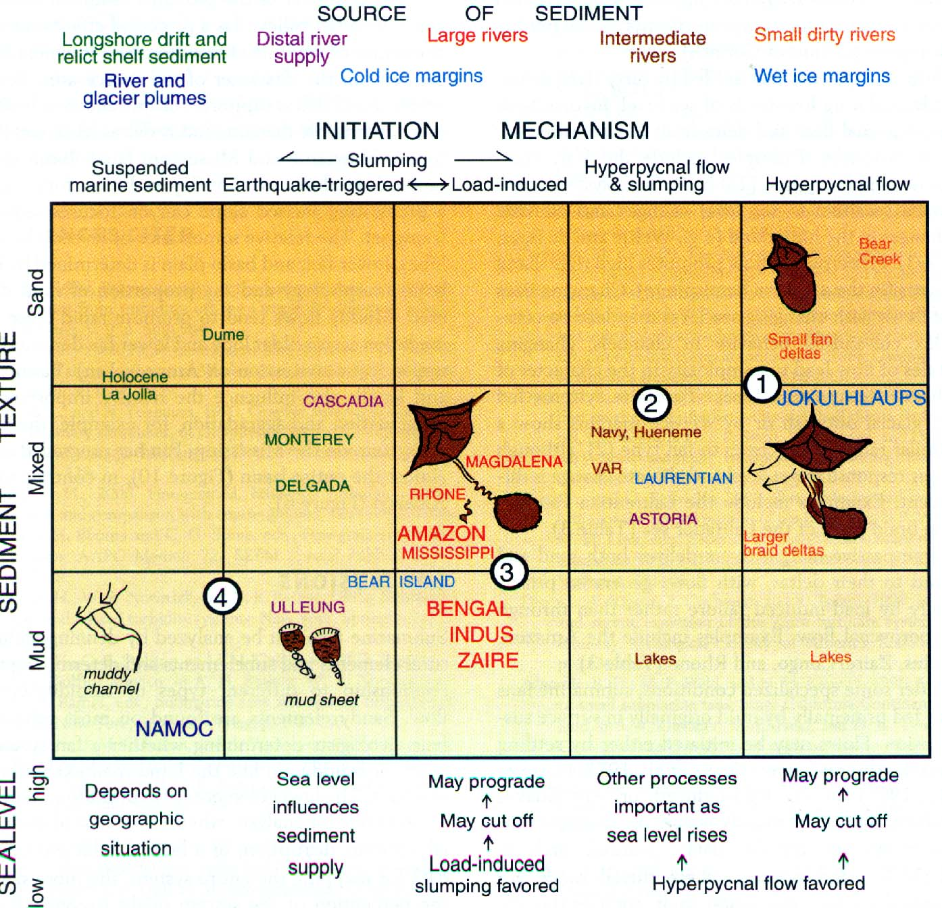
Sediment type - depositional mechanisms

Slide 24
Sediment origin & composition
Origin:
  Weathering and erosion
  Activity of living organisms
  Accumulation of dead organisms- oozes
  Volcanic eruptions
  Chemical processes within the water itself
  Space debris
Composition:
Boulder >256mm Sand 0.062-2mm
Cobble 64-256mm Silt 0.004-0.062mm
Pebble 4-64mm Clay <0.004
Granule 2-4mm

Slide 25
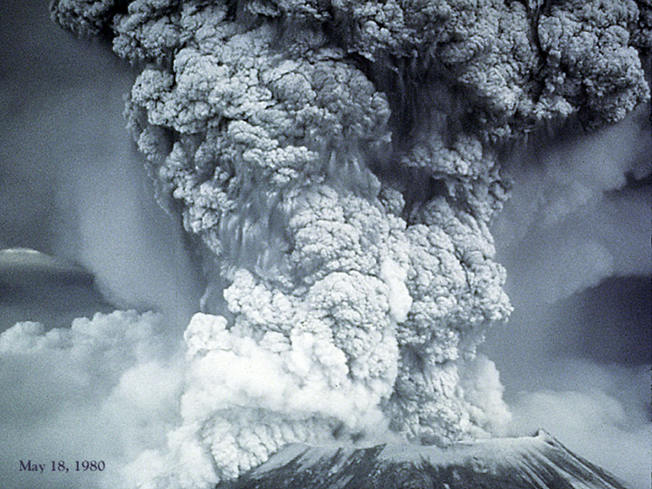
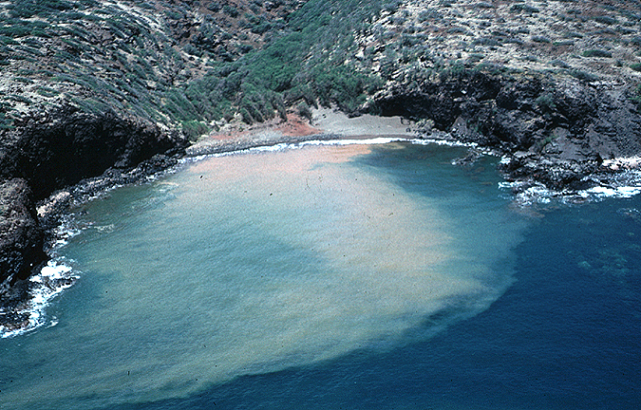
Sources of Sediment
Terrigenous:
  Continental runoff- desert sand blows off continent to ocean
  Volcanic eruptions- dust and magma
  Rivers- washout of sediment

Slide 26
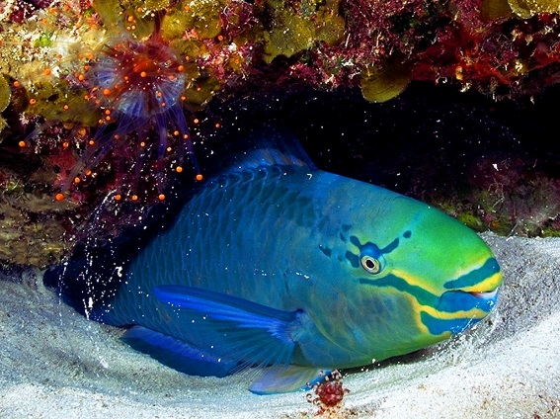
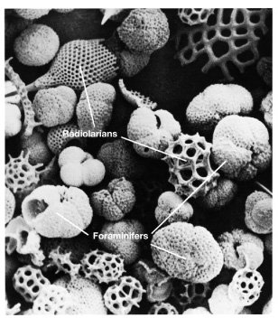
Biogenous:
Mostly calcareous and siliceous
Abundant where ample nutrients encourage high biological productivity
Parrotfish
Oozes: pelagic sediment
containing >30% by volume
microorganism shells

Slide 27
Biogenous sediment composition
Microscopic biogenous tests are composed of 2 main chemical compounds:
  Silica (SiO₂) including opal (SiO₂ · nH₂O)
    Diatoms (algae)
    Radiolarians (protozoan)
  Calcium carbonate or calcite (CaCO₃)
    Coccolithophores (algae)
    Foraminifers (protozoan)

Slide 28
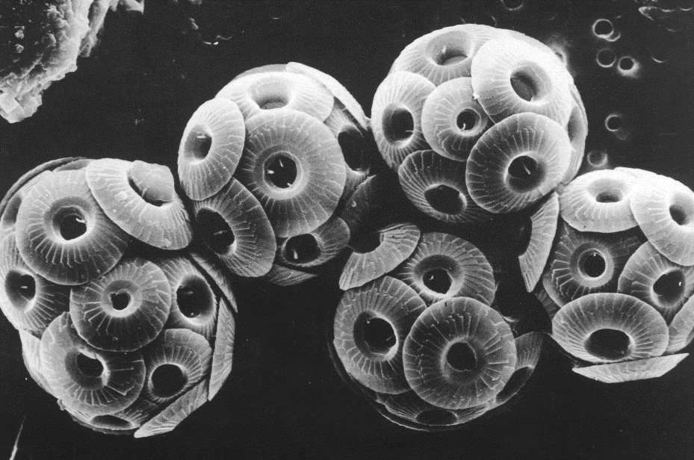
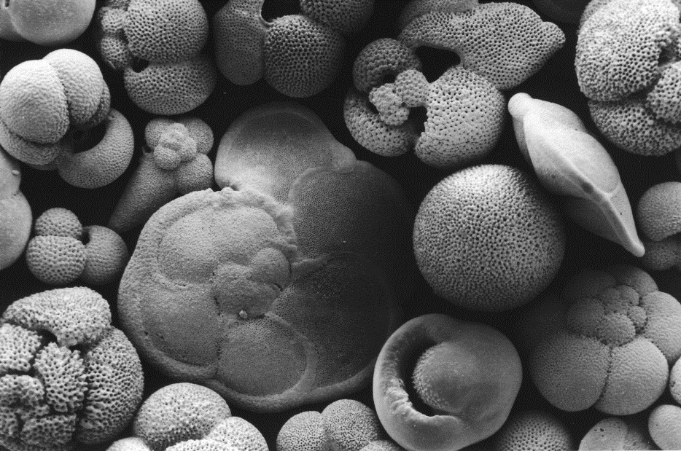
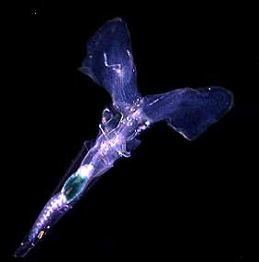
Calcareous Oozes
Coccolithophores
Foraminifers
pteropod

Slide 29
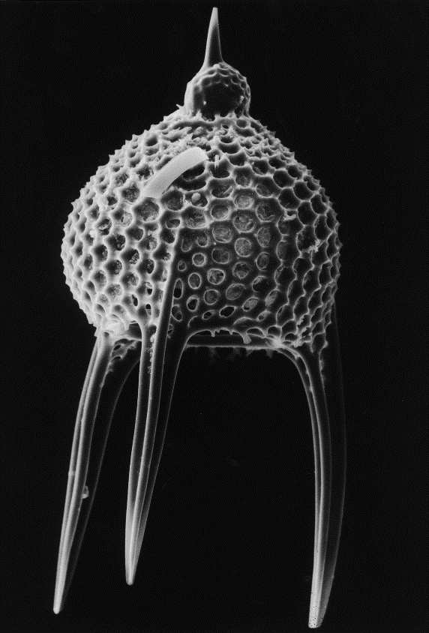
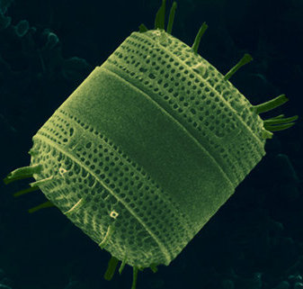
Siliceous Oozes
radiolarian
diatom

Slide 30
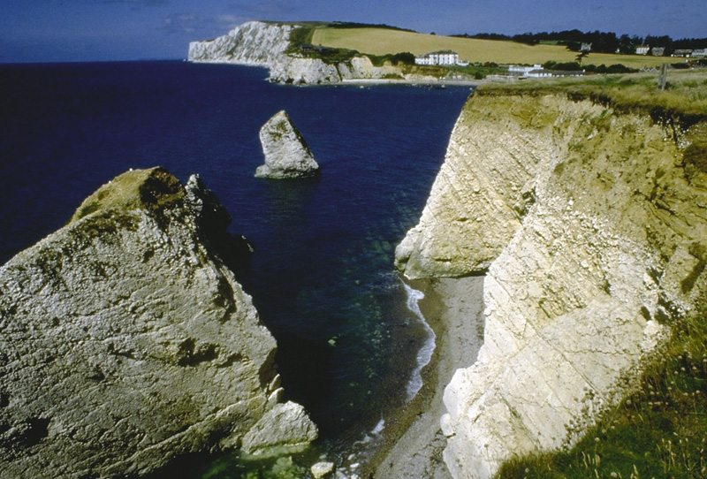
Biogenous ooze turns to rock
When biogenous ooze hardens and lithifies, can form:
  Diatomaceous earth (if composed of diatom-rich ooze)
  Chalk (if composed of coccolith-rich ooze)
Chalk cliffs of southern England

Slide 31
Distribution of biogenous ooze
Most biogenous ooze found as pelagic deposits
Factors affecting the distribution of biogenous ooze:
  Productivity (amount of organisms in surface waters)
  Destruction (dissolving at depth)
  Dilution (mixing with lithogenous clays)

Slide 32
Hydrogenous sediment
Hydrogenous sediment forms when dissolved materials come out of solution (precipitate)
Precipitation is caused by a change in conditions including:
  Changes in temperature
  Changes in pressure
  Addition of chemically active fluids

Slide 33
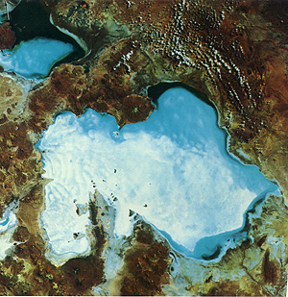
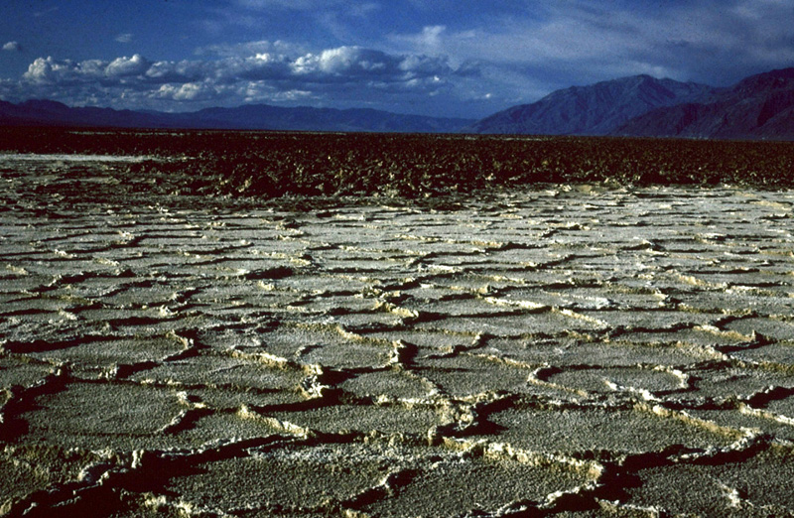
Types of hydrogenous sediment
Manganese nodules
Phosphates
Carbonates
Metal sulfides
Evaporite salts

Slide 34
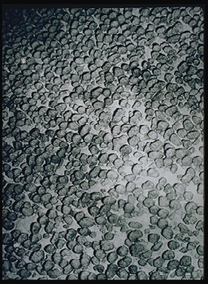
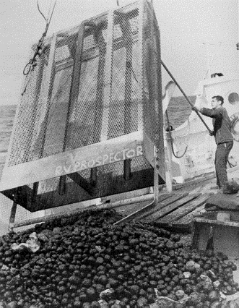
Magnesium nodules:
1st discovered by Challenger expedition (1873-76)
16 million tons accumulate each year
Growth rate: 1-10 mm/million years
Need nuclei to form
Mining has not developed because:
Low international market price for metals
Unresolved legal ownership problems
Technical costs and development
Effect on hydrothermal vent communities unknown
Mining manganese nodules

Slide 35
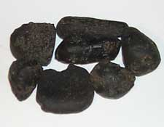
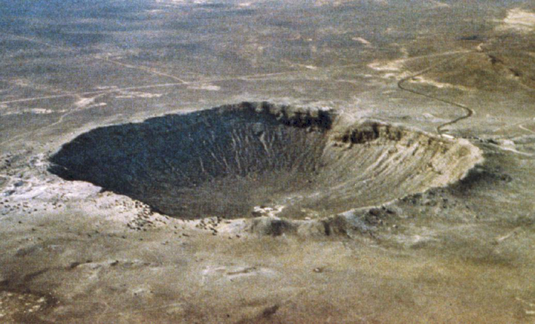
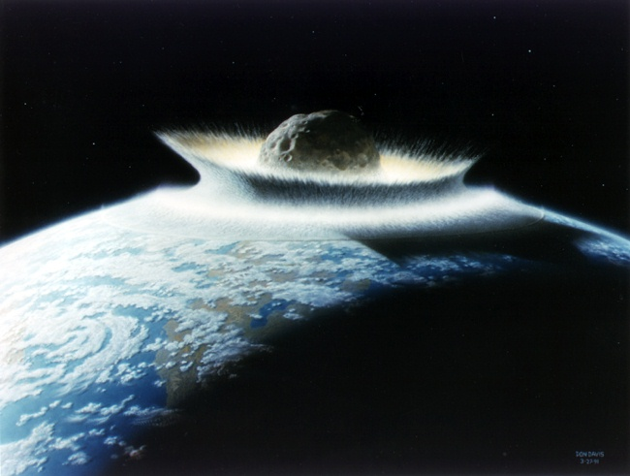
Cosmogenous sediments:
Extraterrestrial in origin
Two main types:
  Microscopic space dust
  Macroscopic meteor debris
  Forms an insignificant proportion of ocean sediment
tektites

Slide 36
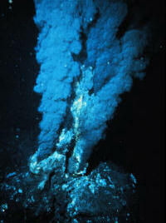
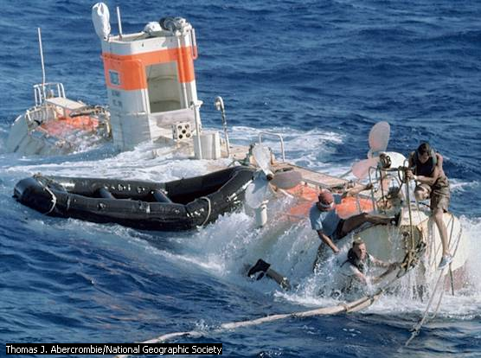
Hydrothermal Vents
Ballard & Grassle (1977)- Alvin to Galapagos
Sulfur-rich vents 660 ºF, but quickly cool to 73 ºF
Thermophilic bacteria associated with vent communities

Slide 37
Formation of Vents
Cold seawater sinks into cracks deep into ocean floor
Water heated by magma rises and leaches out minerals from surrounding rocks
The water emerges from vents and precipitates out minerals

Slide 39
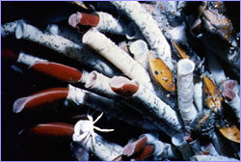
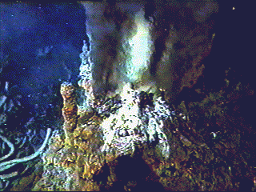
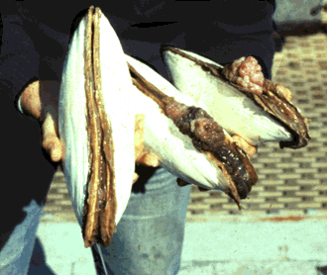
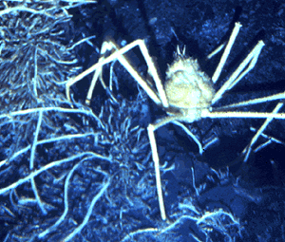
Hydrothermal Vent Communities
Tube worms- pogonophorans
Other orgs:
Calyptogena- large white clam
Large crabs
Sea anemones
Shrimp

Slide 40
Hydrothermal Vent Communities
Support communities with high biomass, but low diversity
Primary producers are chemosynthetic bacteria
90% endemism
Communities are small (25-60m in diameter)

Slide 41
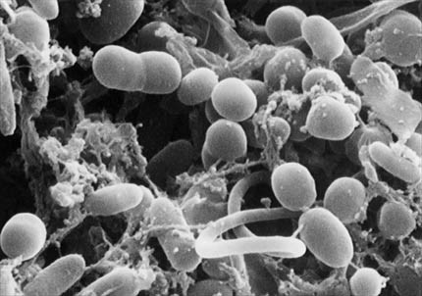
Chemosynthetic Bacteria
Chemosynthesis:
Oxygen + hydrogen sulfide + water + carbon dioxide
sugar + sulfuric acid
60₂ + 6H₂S + 6H₂0 + 6C0₂ C₆H₁₂O₆ + 6H₂S0₄

Slide 42
Photosynthesis
vs
Chemosynthesis
Photosynthesis:
6H₂O + 6CO₂ + nutrients + light energy C₆H₁₂O₆ + 6O₂
Chemosynthesis:
60₂ + 6H₂S + 6H₂0 + 6C0₂ C₆H₁₂O₆ + 6H₂S0₄

